Slide 1
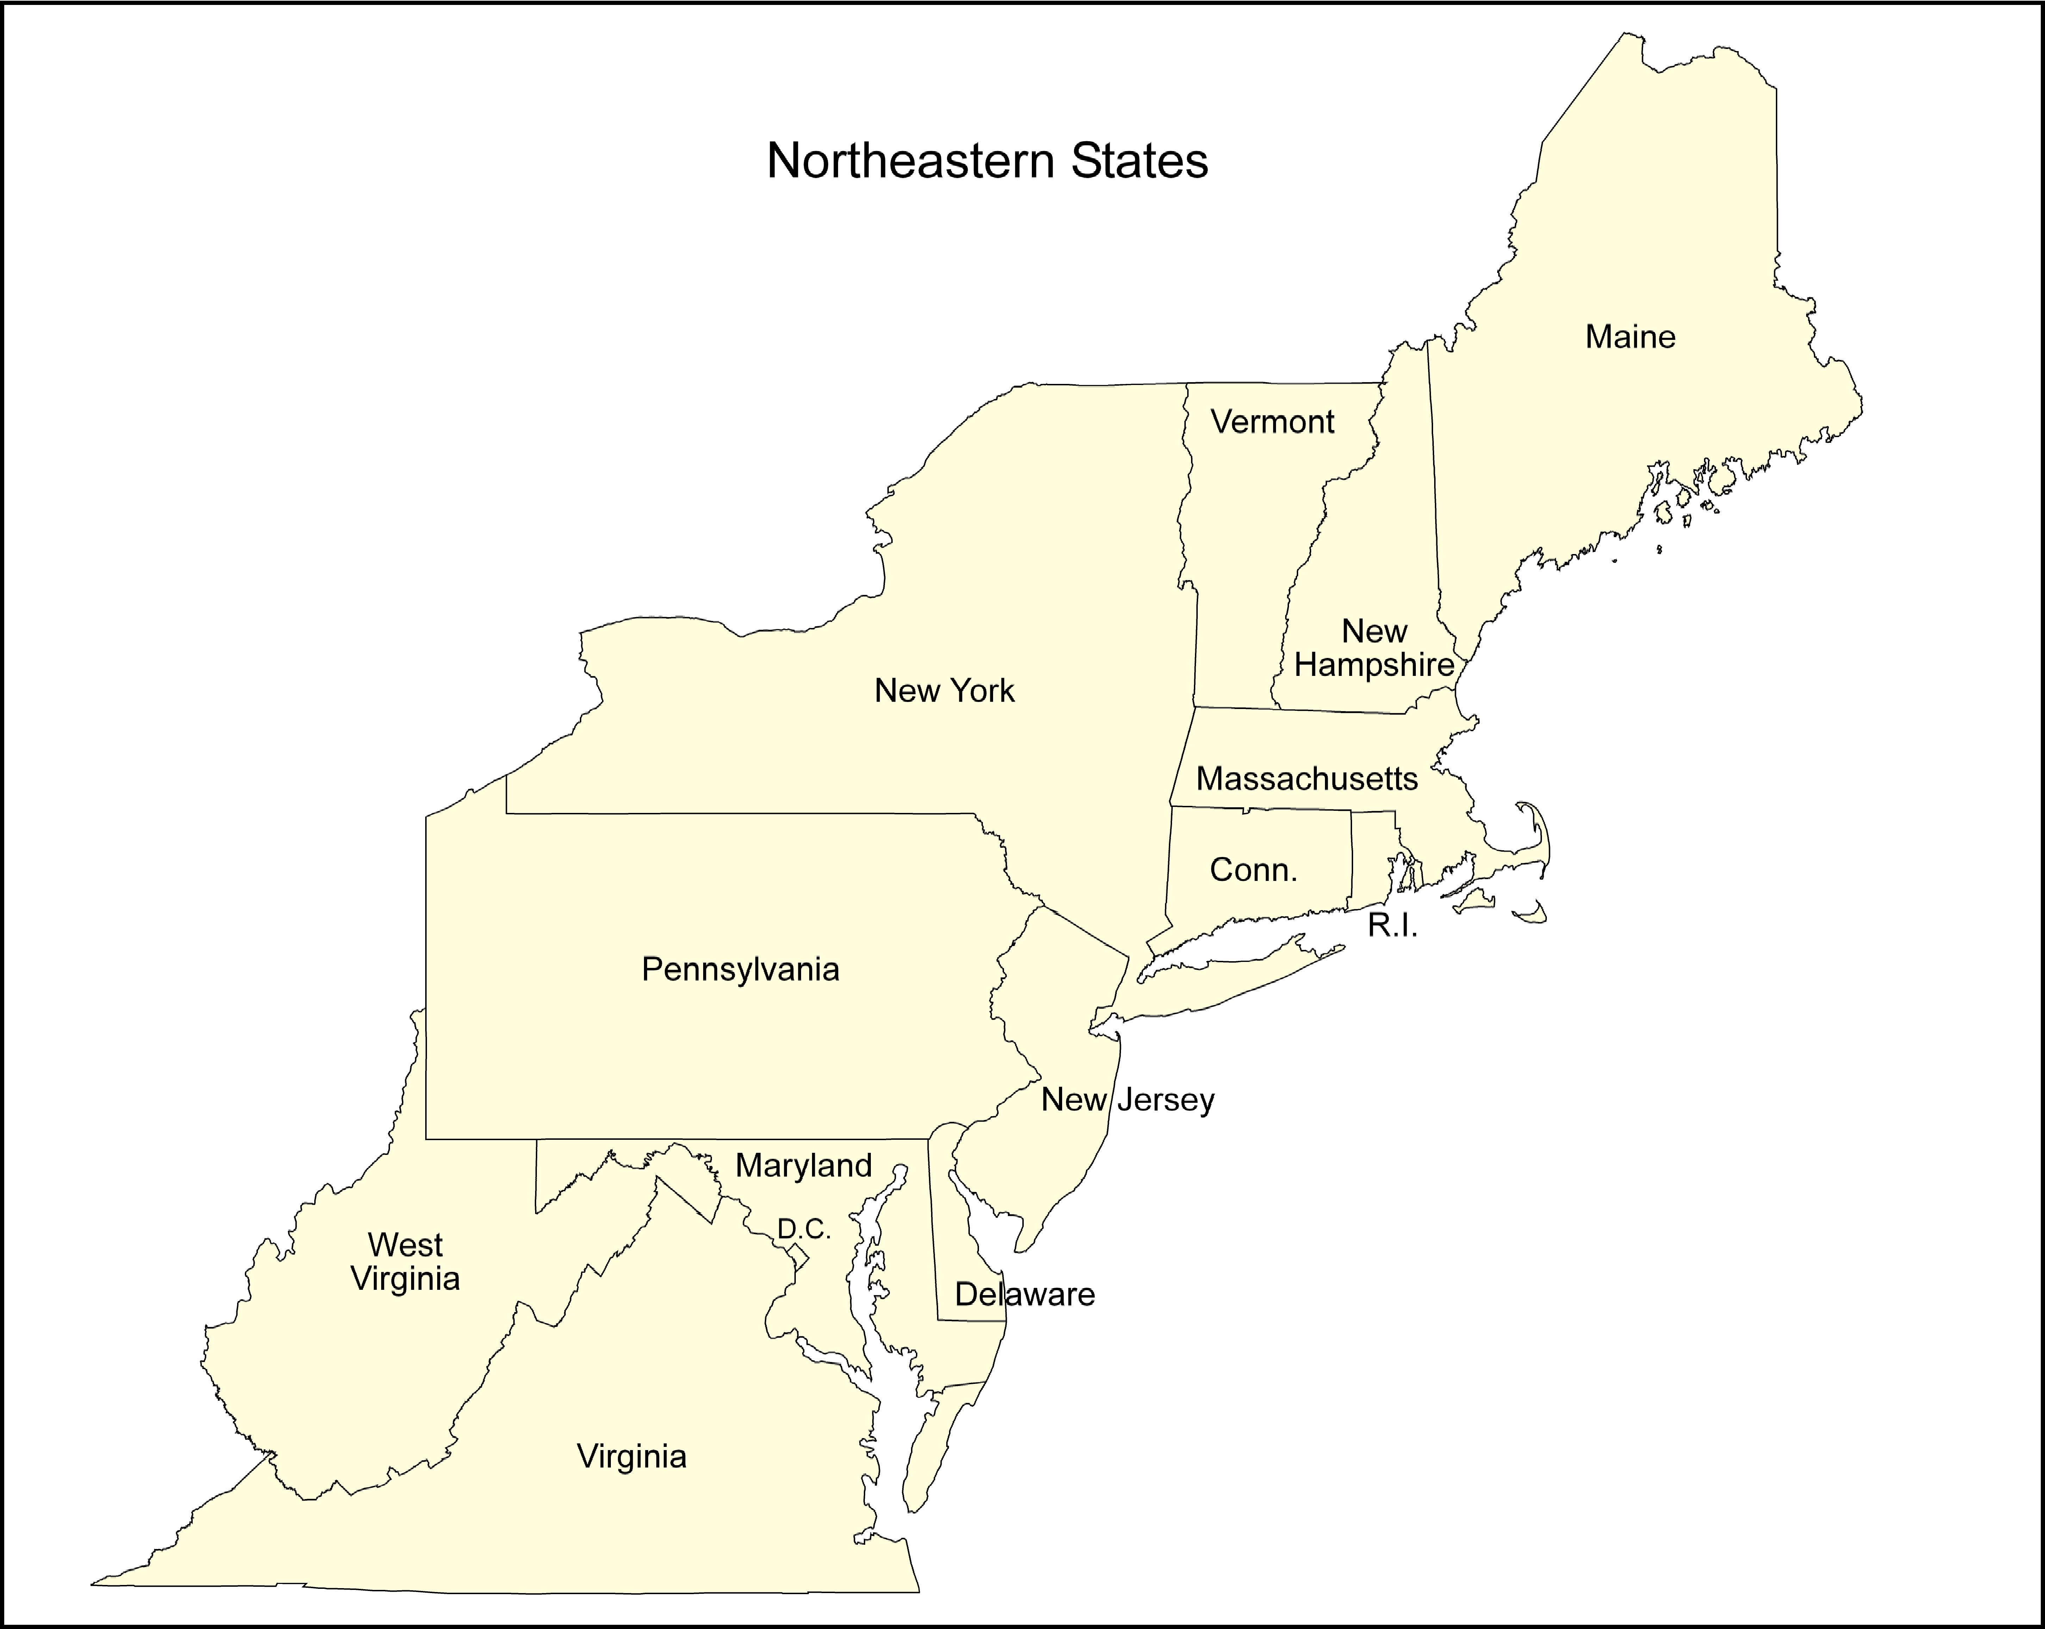
Buffalo
Pittsburgh
NYC
Philadelphia
Baltimore
D.C
Norfolk

